Slide 1
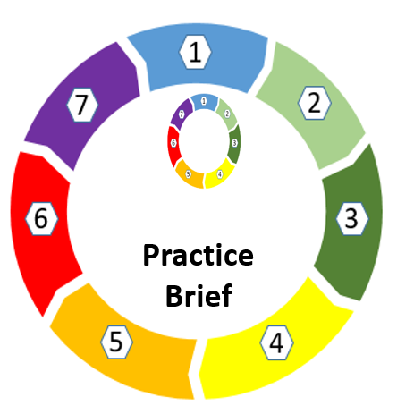
SAR Brenda
January 2023

Slide 2
How to use this document
The aim of this document is to outline the key themes and learning from SAR Brenda. Please share this resource widely. It can be used in conjunction with the SSP Action Plan Proforma
There are also hyperlinks to external resources such as websites which can be accessed by either ctrl+click on the image/icon or hyperlink. Alternatively you can use your mouse to right click and select open link from the options. If you are unable to open a hyperlink please copy the information and paste into your usual internet search engine e.g. Google or Bing.

Slide 3
Brenda was a 75 year old female who passed away at GWH in February 2021.
Prior to her death, a safeguarding adults referral was raised by the community nursing team on January 2021 regarding concerns that Brenda was not eating with a history of depression and at risk of self-neglect.
Brenda lived alone at home and had become estranged from her son. There was little known about her life.
Brenda had multiple health needs (heart disease, kidney disease, Sjogren’s syndrome, anaemia), Depression and experienced Self-neglect. Brenda had contact with services leading up to her death including Community nurses visited weekly to give an Eprex injection, Advanced Clinical Practitioner from GP surgery, GP, Adult Safeguarding Team and Initial Contact Team at Swindon Borough Council.
In November 2021 a SAR was undertaken following Brenda’s death and key areas for learning were identified.
This practice brief sets out these key areas for learning. These areas will be incorporated into the SSP strategic plan and the Learning and Development offer, the outcomes of which will be monitored to ensure they are consistent with the learning to improve frontline practice.

Slide 4
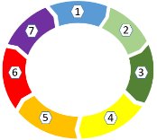
Independent Advocacy
The review highlighted the importance of the use of independent advocacy for adults at risk when adult safeguarding concerns have been raised.
Under the Care Act, The advocacy duty will apply from the point of first contact with the local authority and at any subsequent stage of the assessment, planning, care review, safeguarding enquiry or safeguarding adult review. If it appears to the authority that a person has care and support needs, then a judgement must be made as to:
whether that person has substantial difficulty in being involved, and
if there is an absence of an appropriate individual to support them.
An independent advocate must be appointed to support and represent the person for the purpose of assisting their involvement if these two conditions are met and if the individual is required to take part in one or more of the following processes described in the Care Act:
a needs assessment
a carer’s assessment
the preparation of a care and support or support plan
a review of a care and support or support plan
a child’s needs assessment
a child’s carer’s assessment
a young carer’s assessment
a safeguarding enquiry
a safeguarding adult review
an appeal against a local authority decision under Part 1 of the Care Act (subject to further consultation).
There is a 7 minute briefing available here about Swindon Advocacy Movement.
SAR Brenda
7
Minute Briefing
Assessing capacity including executive capacity
The Mental Capacity Act 2005 (MCA) is designed to protect and empower individuals aged 16 and over and help to safeguard the human rights of people who lack (or may lack) mental capacity to make decisions about their care and treatment.
It is important to consider capacity when self-neglect is suspected. However, always
remember the MCA principle of assuming capacity. This means there is an expectation for
professional curiosity and the testing of executive and functional decision-making capability
and capacity for change.
Research in Practice have a resource on MCA and Self Neglect here

Slide 5
Safeguarding Supervision
The review highlights the need to ensure that safeguarding support mechanisms in place including safeguarding supervision where escalation and acting without consent can be considered and actions agreed.
There is a 7 minute briefing on Supervision on the SSP website on Supervision and Staff Resilience. The SSP also provides training on Safeguarding Supervision. More information can be found here.
7
Self Neglect
The term Self Neglect can cover a wide range of behaviours such as neglecting to care for one's personal hygiene, health or surroundings. it can also include behaviour such as hoarding.
The SSP Self Neglect policy and guidance and the Hoarding guidance can be downloaded from our website. The SSP provide training on Self Neglect for anyone working with vulnerable adults to develop an understanding of self-neglect and the complex issues that can impact a persons ability to make decisions. This training will look at how to balance addressing the issue of self-neglect with an individual’s right to private life and health and how to make safe decisions. Click here.
Minute Briefing
Multi Agency Meetings
Multi-agency working is key to supporting people who are Self Neglecting. Agencies have a duty to respond to abuse and neglect under the Care Act 2014. Key professionals
from any agency or organisation can call Multi-Agency meetings for a person who self-neglects and who they are concerned about in their service. Actions set in a Multi-Agency meeting should be based on the person-centred risk assessment and contribution from all key professionals. These should be utilised where there are concerns that a client may decline care despite their high level of need.
The Care Act
The main principle of the Care Act 2014 is to help to improve people's independence and wellbeing and for care providers and givers to promote a person-centred approach to the care and support they provide
This review recommends that practitioners review their knowledge of key elements of the Care Act 2014 assessment, representation, the wellbeing principle, Section 19. A summary of the Care Act can be found here and the full Care Act can be found here.

Slide 6
Resources for Professionals
SSP training page
Mental Capacity Toolkit
Professional Curiosity

