Slide 1
Harm Outside the Home
Amy McKenzie

Slide 2
Harm Outside the Home – New Pathway
request for support to be made for the child via Contact Swindon by email to contactswindon@swindon.gov.uk. Note: Police will do so via a PPN. Contact Swindon will consider next steps.
Where a child is already open to a social worker or a Lead Professional, they will complete a child exploitation assessment (CERAF) and submit to CERAF@swindon.gov.uk.
Should a Lead Professional submit a CERAF that indicates that a different level of need is present that Opal will submit to Contact Swindon along with the recommendation as to next steps.
Where a child has been reported missing and there are concerns about harm outside the home then the missing coordinator will request that the Lead Professional/ Social Worker complete a child exploitation assessment (CERAF) and submit to CERAF@swindon.gov.uk.
Where there is no Lead Professional / Social Worker, the missing coordinator will complete a request for support to be made for the child via Contact Swindon by email to contactswindon@swindon.gov.uk. Once allocated to a Lead Professional, they will complete a child exploitation assessment (CERAF) and submit to CERAF@swindon.gov.uk

Slide 3
Harm Outside the Home – New Pathway

Slide 4
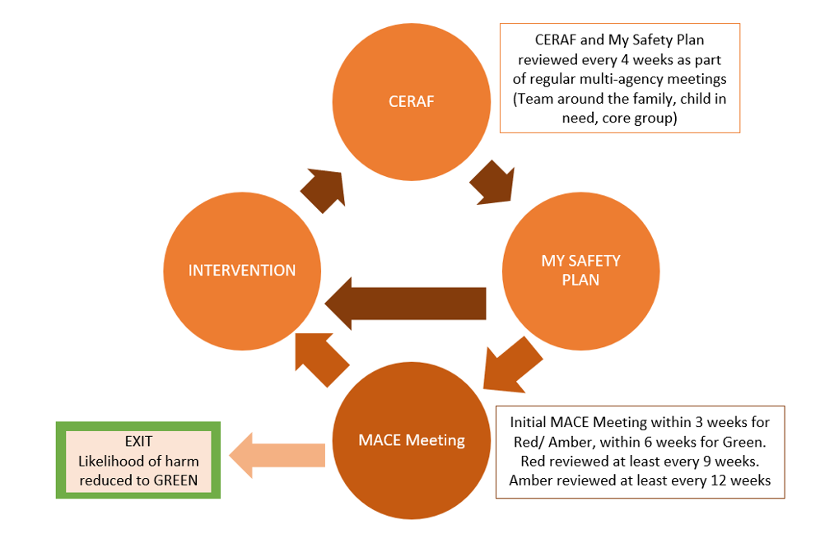
Harm Outside the Home – New Pathway
Assessment:
Emerging – Child has vulnerabilities with emerging concerns over and above peer group. There is no evidence the child is on the cusp of experiencing or is experiencing harm outside the home.
On the cusp – Child is on the cusp of experiencing harm outside the home
Experiencing – Child is experiencing harm outside the home or has already experienced harm outside the home and is on the cusp of experiencing further harm

