Slide 1



An Introduction to
Swindon Safeguarding
Partnership

Slide 2


Swindon Safeguarding Partnership Statutory Requirements
Swindon Safeguarding Partnership oversees the Multi-Agency Safeguarding Arrangements for children and adults at risk as set out in Working Together to Safeguard Children 2023 and the Care Act.

Slide 3

The Multi-agency Safeguarding Arrangements are led by the three statutory Partners:
Lead Safeguarding Partners:
SBC Local Authority, Chief Executive, Samantha Mowbray
Wiltshire Police, Chief Constable, Catherine Roper
BSW ICB Chief Executive Officer, Jonathan Higman
The Lead Safeguarding Partners have delegated their responsibilities to the Swindon Safeguarding Partnership Executive Group.
Delegated Safeguarding Partners
SBC Local Authority Corporate Director of People and Partnership Chair, Clare Deards
BSW ICB Chief Nurse, Gill May
Wiltshire Police, Assistant Chief Constable, Elizabeth Coles
Additional Safeguarding Executive:
Education Representative:
Service Director of Education,
Kashif Nawaz
Notes:
AKA SSP – may been aware of Local Safeguarding Childrens Board and Local Safeguarding Adults Board.
SSP came into effect in July 2019 to oversee the new Multi-Agency Safeguarding Arrangements for children and adults at risk set out in Working Together 2018 and the Care act.
multi-agency arrangements have since been revised to ensure that the Partnership is compliant with the updated Working Together to Safeguarding Children 2023 guidance.

Slide 4

Swindon Safeguarding Partnership comprises of the named statutory safeguarding partners and those agencies and organisations who have varying degrees of contact with children and/or adults with care and support needs and those who care for them throughout Swindon.
Representatives should promote the effectiveness of the Partnership through their responsibility and accountability for the services their agencies deliver to children & adults with care and support needs, and through their ability to influence the effectiveness of their agencies contribution to multi-agency safeguarding.
The Armed Forces Avon & Wiltshire Mental Health Partnership NHS Trust British Transport Police Care Quality Commission (CQC) Charitable and Voluntary Organisations; including faith groups Childminders Children and Family Court Advisory and Support Service Clinical Commissioning Group Dentists Dorset & Wiltshire Fire & Rescue Authority Education Providers including Early Years and childcare settings General Practitioners and other relevant Primary Care Professionals Great Western Hospital NHS Foundation Trust Healthwatch Swindon Housing Providers Prospect Hospice | Independent Fostering Agencies National Health Service England NSPCC Opticians Oxford Health NHS Foundation Trust Probation - The National Probation Service and the Community Rehabilitation Company Pharmacists Residential Care Homes & Care Providers (children & adults) Swindon Borough Council Services The Secure Estate (Prisons, Secure Training Centres etc.) South West Ambulance Service Foundation Trust Swindon Advocacy Movement UK Visa, Immigration, Enforcement and Border Force Wiltshire & Swindon Coroner’s Office Youth Justice Service Where appropriate, other services commissioned by any of the above.

Slide 5

Swindon Safeguarding Partnership comprises of the named statutory safeguarding partners and those agencies and organisations who have varying degrees of contact with children and/or adults with care and support needs and those who care for them throughout Swindon.
Representatives should promote the effectiveness of the Partnership through their responsibility and accountability for the services their agencies deliver to children & adults with care and support needs, and through their ability to influence the effectiveness of their agencies contribution to multi-agency safeguarding.
The Armed Forces Avon & Wiltshire Mental Health Partnership NHS Trust British Transport Police Care Quality Commission (CQC) Charitable and Voluntary Organisations; including faith groups Childminders Children and Family Court Advisory and Support Service Clinical Commissioning Group Dentists Dorset & Wiltshire Fire & Rescue Authority Education Providers including Early Years and childcare settings General Practitioners and other relevant Primary Care Professionals Great Western Hospital NHS Foundation Trust Healthwatch Swindon Housing Providers Prospect Hospice | Independent Fostering Agencies National Health Service England NSPCC Opticians Oxford Health NHS Foundation Trust Probation - The National Probation Service and the Community Rehabilitation Company Pharmacists Residential Care Homes & Care Providers (children & adults) Swindon Borough Council Services The Secure Estate (Prisons, Secure Training Centres etc.) South West Ambulance Service Foundation Trust Swindon Advocacy Movement UK Visa, Immigration, Enforcement and Border Force Wiltshire & Swindon Coroner’s Office Youth Justice Service Where appropriate, other services commissioned by any of the above.

Slide 6

The Purpose and function of the Safeguarding Partnership is to:
Deliver our shared responsibility for the safeguarding of children, young people and adults with care and support needs in Swindon.
Provide effective and informed leadership to the local safeguarding system, evidencing that risks associated with multi-agency safeguarding arrangements are being actively managed.
Promote positive working relationships with each other and children, adults, their unpaid carers and families. Creating a positive culture for learning not blaming.
To actively engage with children, families, and adults with care and support needs and their unpaid carers to influence and improve safeguarding practices and service delivery across the Partnership.
To undertake Rapid Reviews, Child Safeguarding Practice Reviews (CSPR), Safeguarding Adult Reviews (SARs) and multi-agency audits.
Identify and act on learning from the above and provide a learning and development offer to include safeguarding training.
To develop and update multi-agency policies and procedures.
The Swindon Safeguarding Partnership Multi-agency Safeguarding Arrangements can be found here

Slide 7

The Purpose and function of the Safeguarding Partnership is to:
We believe that effective safeguarding is founded on practitioners developing lasting and trusting relationships with the children and adults they work with as well as each other.
We will look beyond organisational constraints and boundaries to build a culture which improves outcomes for all.
We have an agreed behaviours framework that promotes and delivers:
accountability,
openness,
trust,
innovation,
commitment,
respectfulness,
curiosity and
collaboration.

Slide 8
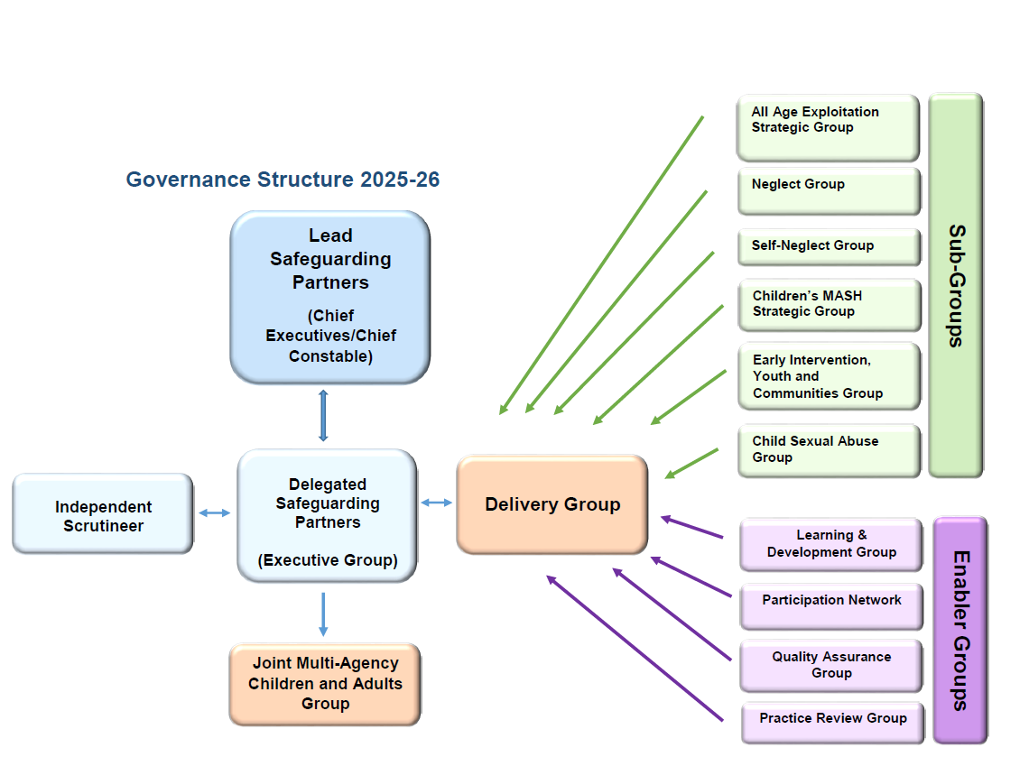

Safeguarding Partnership Structure for 2025-26

Slide 9

Click on the hyperlinks above to find out more about the strategic priorities
Swindon Safeguarding Partnership Strategic Priorities 2025-2026
All Age Exploitation
Child Sexual Abuse
Neglect
Self-Neglect
Child Exploitation
Adult Exploitation
Child Sexual Abuse
Neglect
Self-Neglect

Slide 10
Our Vision
All Age Exploitation:
We aim to identify children and adults in Swindon who are at risk of or who are being exploited and provide an improved multi-agency response that reduces risk of harm.
Child Sexual Abuse:
We will work together with partners to minimise the impact of child sexual abuse on children and young people in Swindon.
We want all professionals to feel enabled to confidently identify, assess and respond to child sexual abuse.
Neglect:
We aim to improve how we identify, assess and respond to children who are suffering from Neglect.
We aim to decrease the number of children in Swindon who are suffering from neglect.
Self-Neglect:
We aim to improve our response to those needing help and decrease the number of adults in Swindon who are self-neglecting.

Slide 11

The Strategic Support Unit is not a frontline safeguarding service.
We are an independent team funded by the statutory partners to support the work of the partnership. We support, drive and project manage the work of the partnership.
Safeguarding Partnership Strategic Support Unit
Strategic Safeguarding Partnership Manager – Hannah Woloszczynska
Safeguarding Partnership Lead for Adults – Faith Margle
Safeguarding Partnership Lead for Children – Jackie Chipping
Safeguarding Partnership Learning & Development Lead – Jackie Barstow
Safeguarding Partnership Business Officer – Lesley Boorman
Safeguarding Partnership Administrator – Leanne Watts
You can contact the team at safeguardingpartnership@swindon.gov.uk
Notes:
From SSP website - Who we are and what we do
The day to day work of the Swindon Safeguarding Partnership is undertaken by Safeguarding Partnership Strategic Support Unit. The unit provides organisational and administrative support for the Executive and Partnership Boards and well as sub groups and multi-agency training and is responsible for the day to day running of the Partnership and is funded by the combined contributions from the statutory partners.
The Partnership Strategic Support Unit helps to provide the infrastructure for successful operation of the Partnership work. Duties will be varied and not limited to:
Maintain communications and knowledge sharing including briefings and web presence, including communicating learning and key messages to all agencies
Maintain partnership plans such as a forward plan, business plan and support subgroup work plans
Preparing agendas, administer and minute meetings of all groups that sit within the arrangements
Support a range of multi-agency practice reviews including coordination management of action plans
Coordinate and administer multi-agency audits
Collate performance information reports and draft annual reports
Support the development of practice forums
Maintain links with training and development to ensure workforce needs are being addressed
Maintain links and joint working with other partnerships and Boards

Slide 12

What does this mean for you?
You may be involved with the safeguarding partnership in a variety of ways, for example representing your agency/service on one of the safeguarding partnership groups or being involved with the development of policy and guidance, being part of multi-agency audits or accessing training.
It is important that you have an overview of the safeguarding partnership and its work. Additionally there are expectations of you when you are involved and some key points are included in the following slides.
Each partnership group will also have a terms of reference which provides additional guidance.

Slide 13

Expectations of Agency Representatives
All agency representatives play a role in supporting the safeguarding partnership to implement clear policy and procedural arrangements to enable a multi-agency approach to safeguarding.
To support effective collaboration: it is vital that every individual working as a representative in the safeguarding partnership is aware of their role and the role of other professionals within the structure and arrangements that set out the safeguarding partnership approach to fulfilling the legal duties as set out in legislation.
Representatives are expected to hold partners or relevant agencies to account where they may not meet the expected safeguarding arrangements.

Slide 14

Primary Role and Function for all Safeguarding Partnership Representatives
Ensure that you are aware of and have read the Safeguarding Partnership Multi-Agency Safeguarding Arrangements and key legislation Working Together to Safeguard Children (2023) and Care Act (2014).
Be clear on, and carry out, your strategic safeguarding role as your agencies representative.
Allocate sufficient time to the work of the Partnership, attending meetings as a priority or having a named, briefed deputy to attend.
Speak with authority for the agency or organisation you represent and be able to request your organisation deploys resources to support the safeguarding of children and adults with care and support needs work
Ensure that staff and volunteers within your organisation are kept fully informed of the Partnerships work.
Take decisions on behalf of your agency or organisation and commit them on policy, resourcing, and practice matters.
Refer back to your organisation to account on all matters relating to safeguarding children and adults with care and support needs and to recommend ways to implement necessary changes within their organisation.
Hold your own agency or organisation to account on how effectively they participate and implement the local published arrangements.
Take a lead on ensuring that learning is cascaded through your agency and organisation and hold your agency to account on measuring impact of that learning on practice.
Partnership agency representatives have a duty of candour (open and honest transparency) by proactively bringing to the attention matters of high risk at the earliest opportunity.

Slide 15

Dispute Resolution
Swindon Safeguarding Partnership will expect and support organisations and agencies to hold one another to account and to challenge appropriately when concerns or disputes relating to the effectiveness of the multi-agency safeguarding arrangements arise.
The Safeguarding Partnership will maintain a risk register to document organisational and strategic issues that might impact on the Safeguarding Partnership’s ability to meet its statutory obligations.
The Risk Register will be reviewed by the Safeguarding Partnership’s Executive and a summary of the risks and mitigating actions as well as the impact of challenge will be included in the Safeguarding Partnership’s annual report.

Slide 16

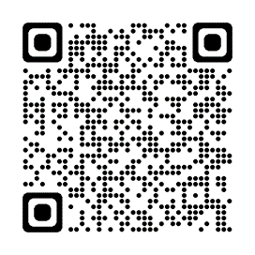
To Find Out More
Additional information is available on our website and this will be relevant to you if you are representing your agency at meetings or if you just want to know more about the partnership and local strategic priorities.
Swindon Safeguarding Partnership Multi-agency Safeguarding Arrangements
Annual report - Swindon Safeguarding Partnership
Information sharing agreement - Swindon Safeguarding Partnership
Swindon Safeguarding Partnership Business Plan 2025-26
Strategic Support Unit - Swindon Safeguarding Partnership
Notes:
Tweak links

Slide 17

Swindon Safeguarding Partnership Website
We offer a range of information and resources including:
Training and Blended Learning Resources
Multi-agency Training
7-minute briefs and learning resources to improve practice - Swindon Safeguarding Partnership
Video archive - Swindon Safeguarding Partnership
Newsletters - Swindon Safeguarding Partnership
Monthly Safeguarding Theme Events - Swindon Safeguarding Partnership
Webpages – information for professionals including practitioner toolkits
For professionals Information - Swindon Safeguarding Partnership (children)
For professionals Information - Swindon Safeguarding Partnership (adults)
Reviews relating to children and adults
Local Child Safeguarding Practice Reviews and Case Learning leaflets - Swindon Safeguarding Partnership
Safeguarding Adult Reviews (SAR's) - Swindon Safeguarding Partnership
Domestic Homicide Review (DHR) - Swindon Safeguarding Partnership
Local Policies and Guidance
Children and young people policies and guidance - Swindon Safeguarding Partnership
Adults policies and guidance - Swindon Safeguarding Partnership

Slide 18

To find out more visit our website: Swindon Safeguarding Partnership.
You can also follow us on @SwindonSafegua1
or use the QR code

