Slide 1
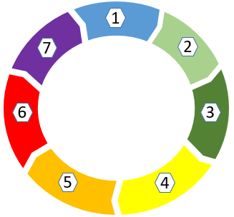
Suspected Bruising on Children
Background Bruising is the most common presenting feature of physical abuse in children. The Triennial analysis of Serious Case Reviews (SCR’s) identified that those under the age of 1 year are consistently over presented in SCR’s as a result of a severe injury or death as a result of physical abuse (Sidebotham et al, 2016). This short clip (from Nottinghamshire Council) describes the action a practitioner should take if they become aware of a bruise/suspicious mark on a non-mobile baby.
What to do when you suspect a Non Accidental injury or bruise If the child has been seriously injured call 999 immediately Refer to MASH who will convene a strategy discussion.
Provide parent/carer with Bruising in non mobile babies leaflet Do not ask the parents to attend hospital or GP at this stage If the child is already open to Children's Social Care contact the allocated social worker or their manager.
Why it matters Recent Rapid Reviews in Swindon have highlighted a lack of awareness of the Suspected Bruising or Unexplained Injury in a child who is not independently mobile policy. The younger the child, the greater the risk that bruising is non accidental and therefore there is a greater potential risk. Infants under the age of 1 are more at risk of being killed by another person, usually a carer, more than any other age group of children.
Minute Briefing
7
What to look for Bruises away from bony prominences Bruises to soft areas such as face, abdomen, arms, buttocks, ears and hands
Multiple or clustered bruising
Imprinting or Petechiae (small red or purple spots caused by bleeding into the skin)
Symmetrical Bruising
Sentinel injuries
A sentinel injury is a ‘minor’ injury often seen in non mobile children and is recognised as a precursor to a more significant injury. A systematic review by the Royal College of Paediatric Health (2020) identified a bruise was the most frequent sentinel injury.
Questions to ask
Have carers been asked for an explanation? Record the explanation. Do not suggest how it may have occurred
When was the bruising first noticed?
Is the injury consistent with child's developmental stage?
It is also important to document the injury on a body map
Use of professional judgement Professional judgement is based on your role, training and experience. However, it is important to recognise that non accidental injuries often occur on the same areas as accidental ones. It is vital that a professional demonstrates professional curiosity when seeking explanations, this is especially important if the professional feels as though they know the family well.
safeguardingpartnership.swindon.gov.uk

Slide 3
Body Map

Slide 4
Useful resources
Contact numbers:
MASH: 01793 466903
EDS: 01793 463699
South Safeguarding Team: 01793 463267
North Safeguarding Team: 01793 466922
For further guidance refer to the local multi-agency procedure: SSP Suspected Bruising or Unexplained Injury in a child who is not independently mobile
NSPCC Core Info leaflet: Bruises on Children

Slide 6
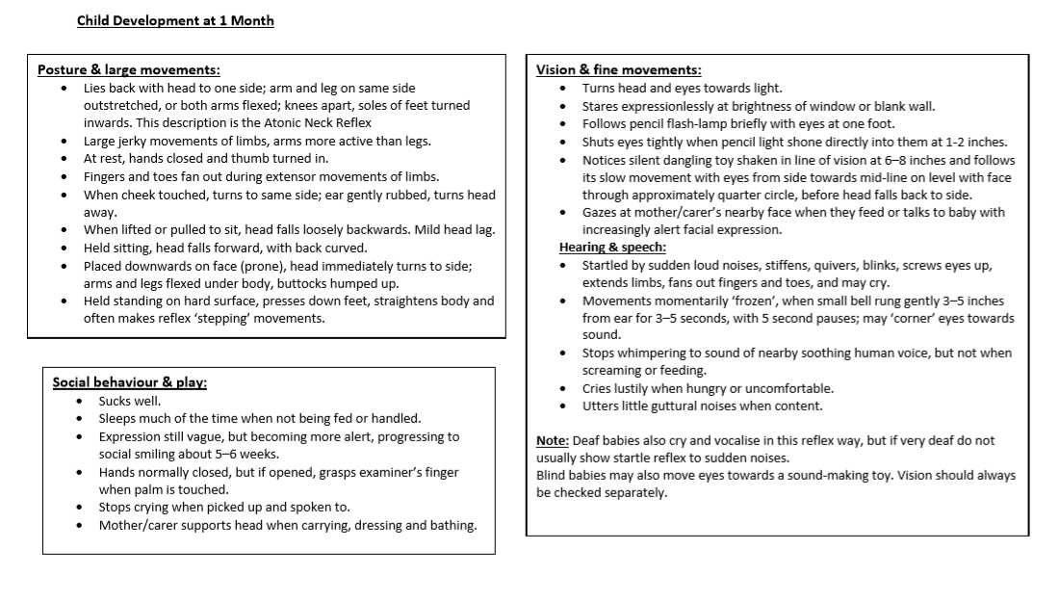

Slide 7
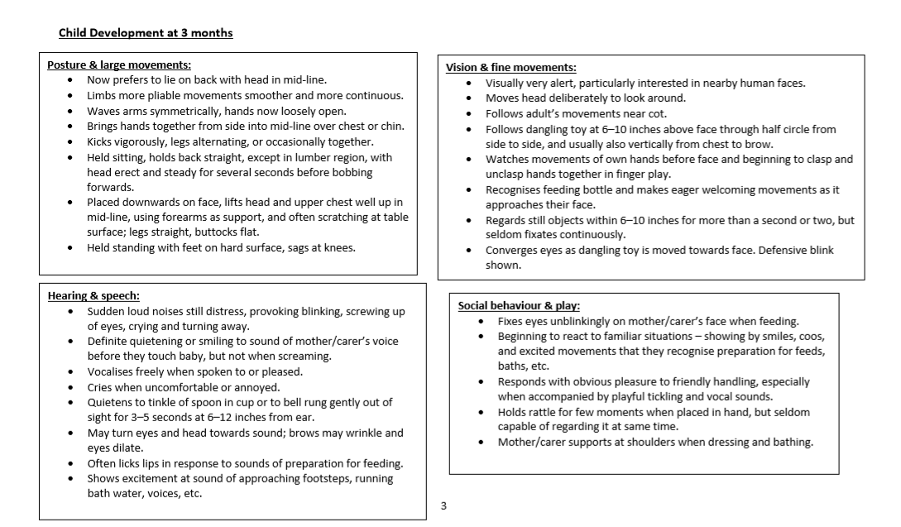

Slide 8
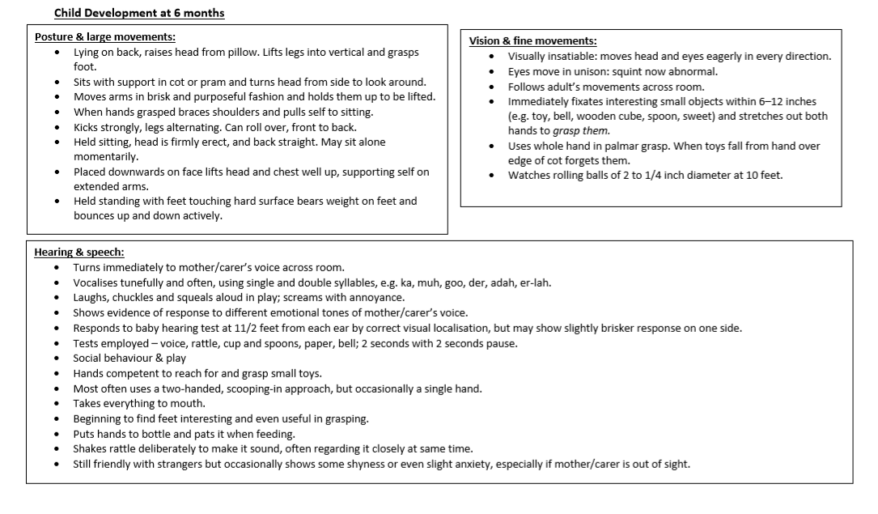

Slide 9
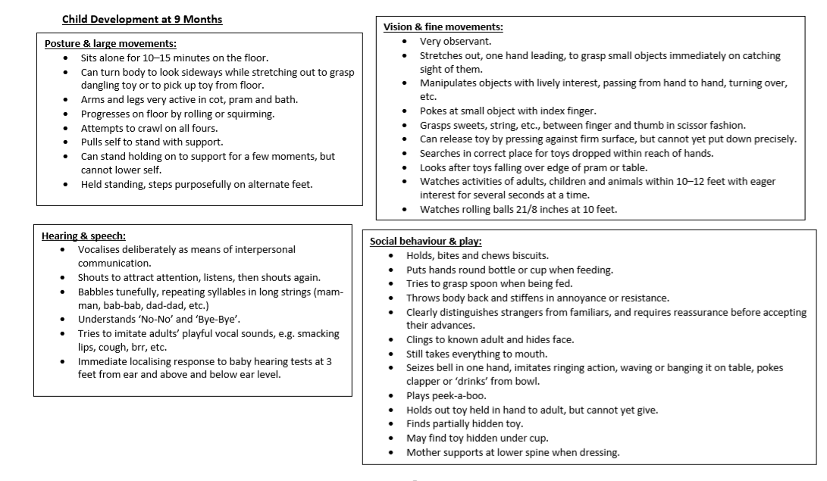

Slide 10
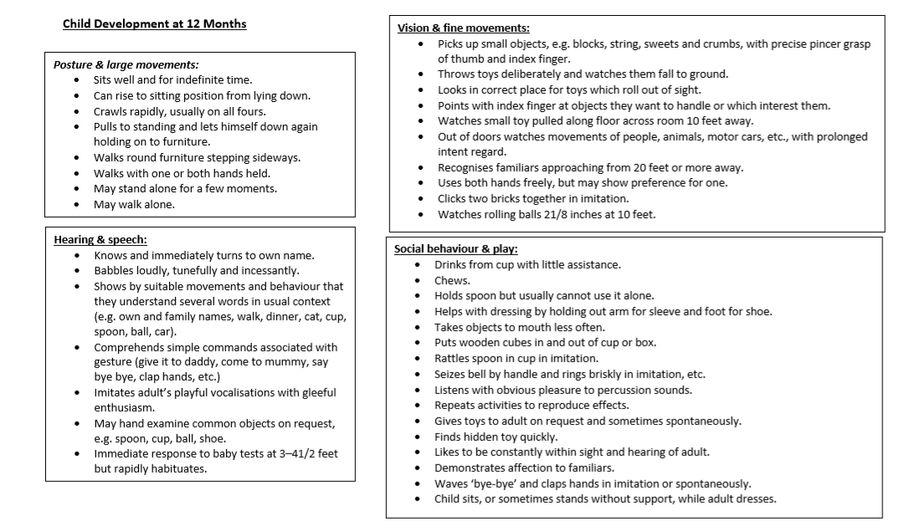

Slide 11
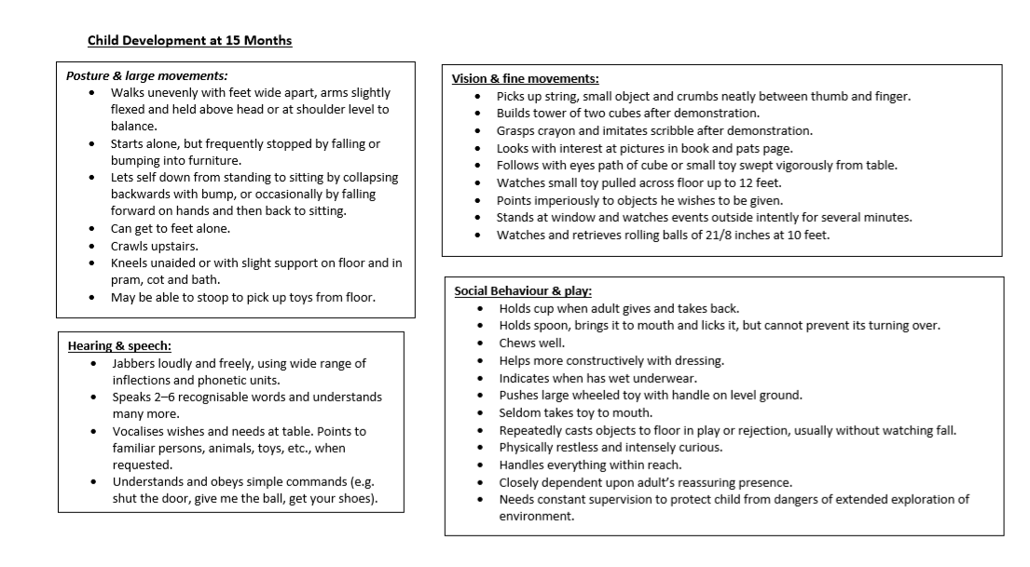

Slide 12
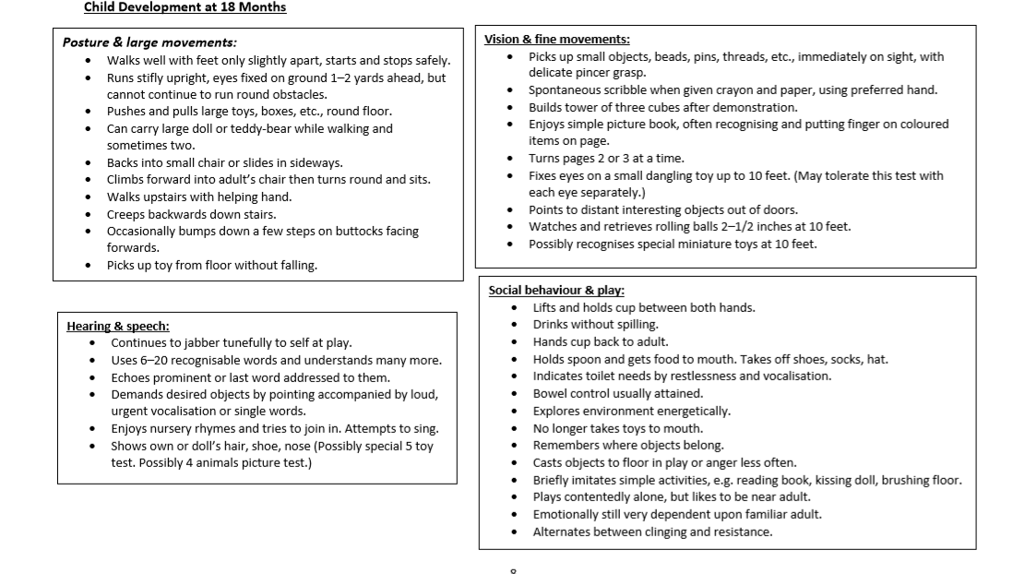

Slide 14
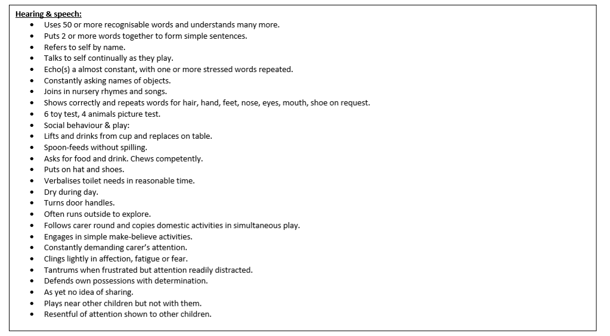

Slide 15
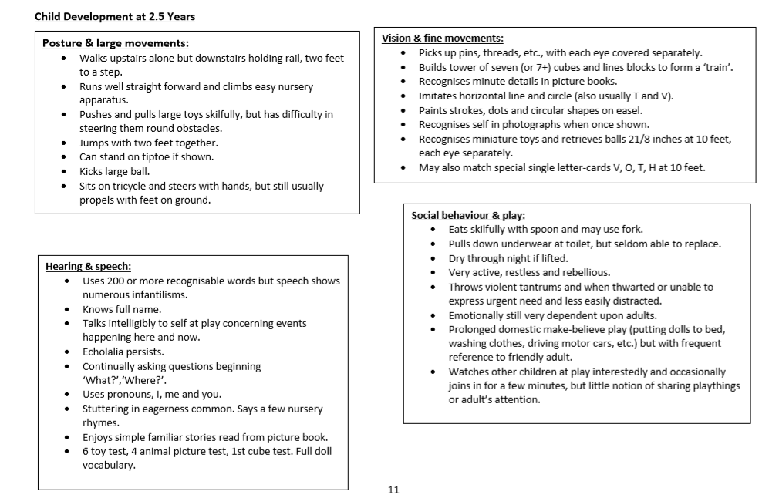

Slide 16
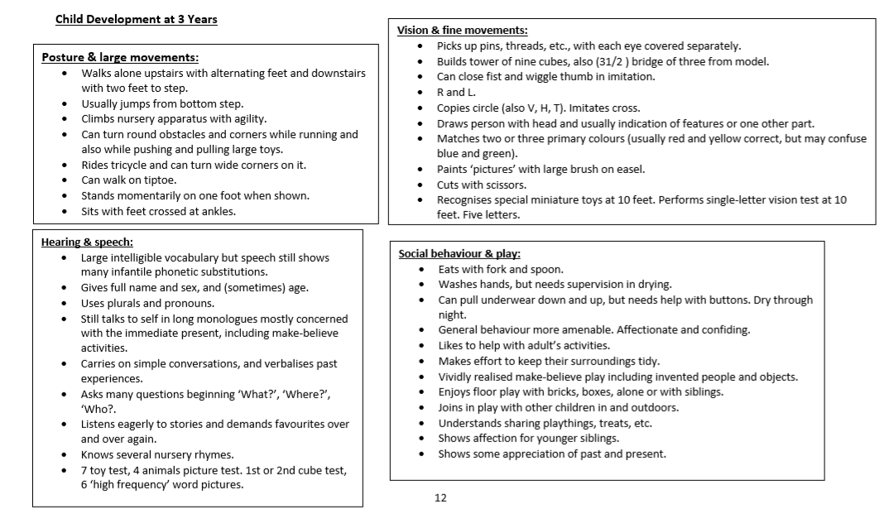

Slide 17
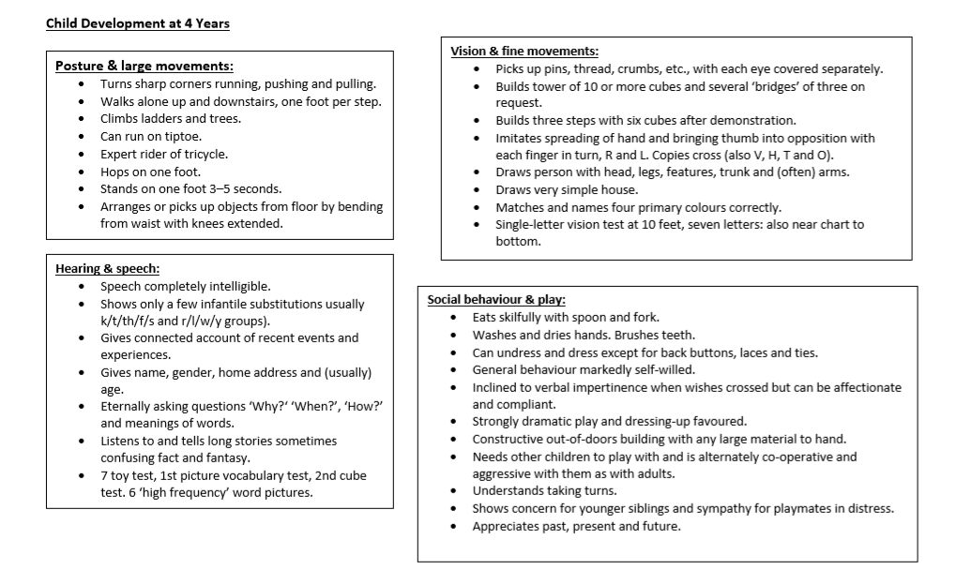

Slide 18
