Slide 1
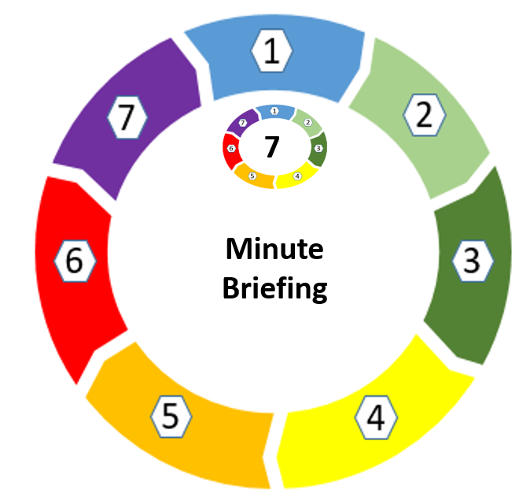
Title: Safeguarding Children – Oral Health
For best viewing of this resource please read in slideshow mode.
26/10/21: Developed by Gillian Tripp, Senior Oral Health Promoter, Great Western Hospitals Foundation Trust

Slide 2
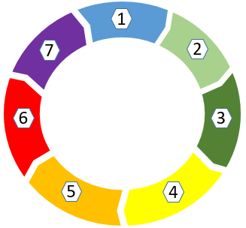
1.Local Picture: Each year in the county of Wiltshire (including Swindon) 1000+ children have teeth removed under general anaesthetic because of tooth decay. The decay rate in Swindon is above the national average for 5 year olds (28.9% compared to 20.4% in England 2018/19) Access data here
In Swindon between 8–10 children each week are admitted to Great Western Hospital (GWH)/other local general hospitals for teeth extractions under general anaesthetic. In Swindon the latest research shows the following:
24.7% reception year pupils were overweight or obese.
36.1% of year 6 pupils were overweight or obese.
66.1% of adults were overweight or obese.
Eating a healthy diet for teeth also supports a healthy lifestyle. There is a strong correlation between obesity and poor oral health. More information about overweight/obesity click here.
2.Causes of Dental Diseases in children and adults.
i) Tooth Decay: We all have bacterial plaque growing on our teeth, both children & adults. 20 minutes after brushing it away, it starts growing again. When we eat/drink anything that contains sugar the plaque bacteria converts the sugar to an acid. The higher the frequency of eating sugar, especially between meals, the higher levels of acid are produced. The acid produced demineralizes the enamel on our teeth and starts the process of tooth decay. If foods/drinks containing sugar are frequently eaten between meals then the acid levels in the mouth will stay high.
ii) Gum Diseases: If bacterial plaque is left around the gum area, gums become inflamed from the toxins produced from the bacteria . If not brushed away, the gums will become diseased the start of gum disease is evident in children’s mouth’s if regular effective tooth brushing doesn’t take place. Gums will be swollen and bleed easily.
7
3. Diet. Sugar should be kept to mealtimes only in measured amounts. If a child (or adult) has a diet high in sugar at high frequency rates, then disease in the mouth will occur e.g.
Bottles with drinks containing sugar
Poor nutrition, high sugar / convenience foods at mealtimes and snack times
Minute Briefing
4. Good Practice Tooth Brushing: As soon as a tooth appears it should be brushed.
Use a smear of tooth paste with 1000 parts per million (ppm) until the age of three, then a pea sized amount of tooth paste after three years - adult with a fluoride content of 1350 – 15000 (ppm)
Brush before bed time and one other time in the day
Leave brushing for one hour after eating
Use a tooth paste that contains fluoride
The impact of untreated dental disease
Toothache/pain/infection
Disturbed sleep
Difficulty eating or change in food preferences
Absence from school and interference with play and socialisation

Slide 3
7. How do I assess if this is neglect and how do I make a safeguarding referral?
Local information about neglect/resources to aid assessment and decision-making visit the Swindon Safeguarding Partnership (SSP) webpage Neglect and GCP2. See also the SSP Neglect Framework and Practice Guidance, Graded Care Profile 2 (GCP2) and Neglect Screening Tool. If you suspect a child/young person is being abused/neglected, or you are concerned about their welfare/well-being you should report your concerns. Further advice is available here.
7
6. Dental Neglect:
Dental neglect is defined by the British Society of Paediatric Dentistry ​as: ‘...the persistent failure to meet a child’s basic oral health needs, likely to result in the serious impairment of a child’s oral or general health or development.’ ‘Dental disease, like any other finding in cases of suspected abuse or neglect, should never be interpreted in isolation but always assessed in the context of the child’s medical and social history and developmental stage.’
Further guidance on assessing dental neglect is available on British Dental Association (BDA) website and the Royal College of Paediatrics and Child Health website.
Minute Briefing
5. A child could be at risk of:
being teased because of poor dental appearance
needing repeated antibiotics
repeated exposure to the morbidity associated with general anaesthesia
severe acute infection which can cause life-threatening systemic illness.
*See slide 4 for images of healthy teeth and gums and those with dental decay.
Consider the following which may indicate concerns regarding neglect:
Dental hygiene poor/not registered with a dentist
failure to seek or delay seeking dental treatment after advice given.
failure to comply with or complete treatment after advice given
failure to provide basic oral care after advice given
See additional resources slide for useful websites/information.
Oral health is also quite a significant issue for children with special needs. Further information is include on slide 5.
Notes:
V2

Slide 4
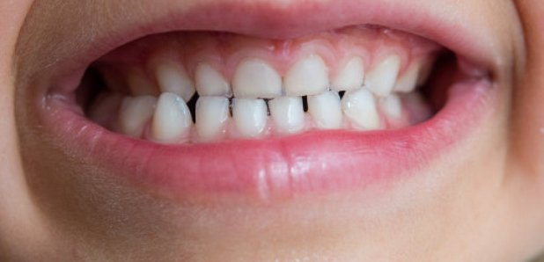
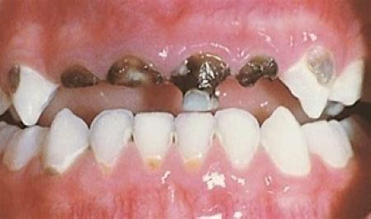
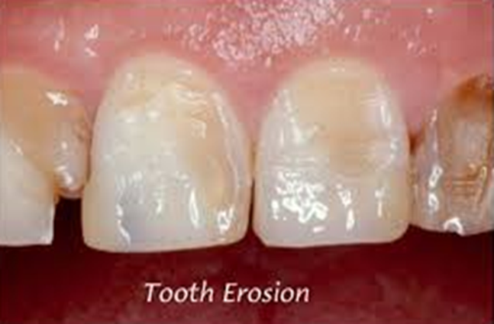
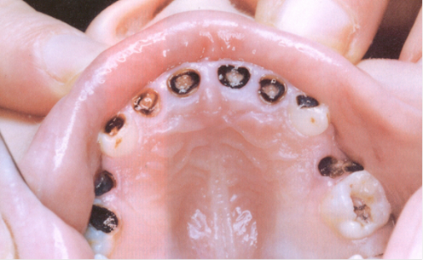
Comparison images of a healthy mouth/teeth and tooth decay
This is an example of a healthy child’s mouth. Pale pink gums and clean, shiny teeth.
The same appearance would be seen in an older child or adults mouth
This is bottle carries in the mouth of a young child. This happens when a child is left to ‘graze’ frequently on a bottle containing sugary drinks.
Many children have to undergo more than one general anaesthetic to remove teeth. Some parents consider this as ‘the norm’.
This is a picture of tooth erosion. This occurs when tooth enamel is worn away. Teeth appear transparent, the edges of the teeth wear down, uneven and are extremely sensitive.
Causes:
Frequent Fizzy drinks (diet or regular),
Fruit juice and squashes.
Foods, (vinegars, pickles, fruits,)
Medication ( inhalers)
Other causes:
Illnesses Anorexia, Bulimia, Pregnancy and hiatus hernia
This is rampant tooth decay in a three and a half year old, caused by a poor diet high in refined carbohydrates and sugar, and insufficient tooth brushing.

Slide 5
Finding a dentist for Children with additional needs
You can access the GWH Community Dental Service can provide treatment to children with additional needs.
Please read further information by following the link below:
https://www.gwh.nhs.uk/wards-and-services/a-to-z/dental-services/community-dental-service/special-care-dental-service/
If you would like a child to be referred please contact: gwh.dentaladmin.teamoffice@nhs.net
Referrals are accepted for children who, because of their disabilities need dentistry in a special care setting.
These may include:
Severely medically compromised
Learning disabilities
Autistic spectrum disorders
Bleeding disorders
Severe physical disabilities
Children with repaired cleft lip/palate
Children under five years of age with extensive decay for whom treatment has proved unsuccessful
Looked after children and those under the Child Protection Plan

Slide 6
Additional Resources
Finding a dentist:
To find a dentist or if there are concerns (pain/trauma) Monday – Friday call helpline 0345 758 1926
Weekends/bank holidays: Contact NHS 111. Further guidance is included here.
Helpful Resources for Oral Health Promotion
Updating knowledge , ‘Delivering Better Oral Health ‘(DH Toolkit) publications@phe.gov.uk
The Oral Health Foundation www.dentalhealth.org
www.dentalbuddy.org
www.nhs.uk/change4life-beta/sugar
www.sugarsmart.org
Oral Health Promotion for training and e-learning packs gwh.oralhealthpromotion@nhs.net
Swindon Safeguarding Partnership resources regarding professional curiosity, effective information sharing and consent and capturing the voice of the child.

